Slide 1
Predicting Rainfall in Australia
PROJECT GROUP #3
Hanumasri Bollepalli (801104071)
Madhuri Pawle (801083244)
Pavanitha Jampala (801131462)

Slide 2
Contents
Introduction
About the Dataset
Visualizations
Data Preprocessing
Machine Learning Model
Evaluating the Model
Conclusion

Slide 3
Introduction
The aim of the project is to predict if it will rain in Australia.
The target audience is the general public of Australia.
EDA (Exploratory Data Analysis) was performed to visualize various important trends.
A logistic regression model was trained to predict rain.
The model was evaluated using various classification metrics.

Slide 4
About the Dataset
This dataset contains about 10 years of daily weather observations from numerous Australian weather stations.
It consists of 24 columns and 142193 rows. It has numerical, categorical and boolean data.
It is an unbalanced dataset, as the target column RainTomorrow has 110316 "No" entries and 31877 "Yes" entries.

Slide 5
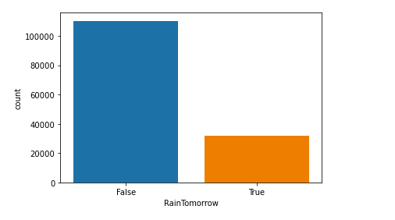
Visualizations
Visualizing the Target Variable

Slide 6
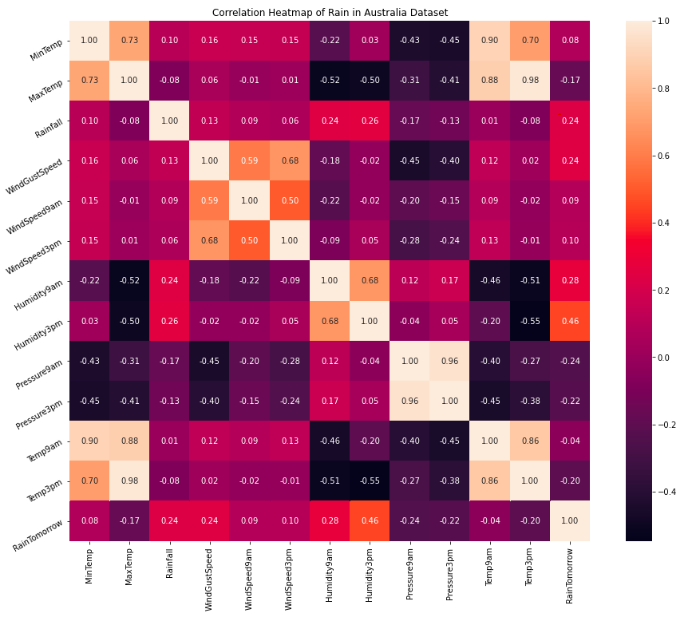

Slide 7
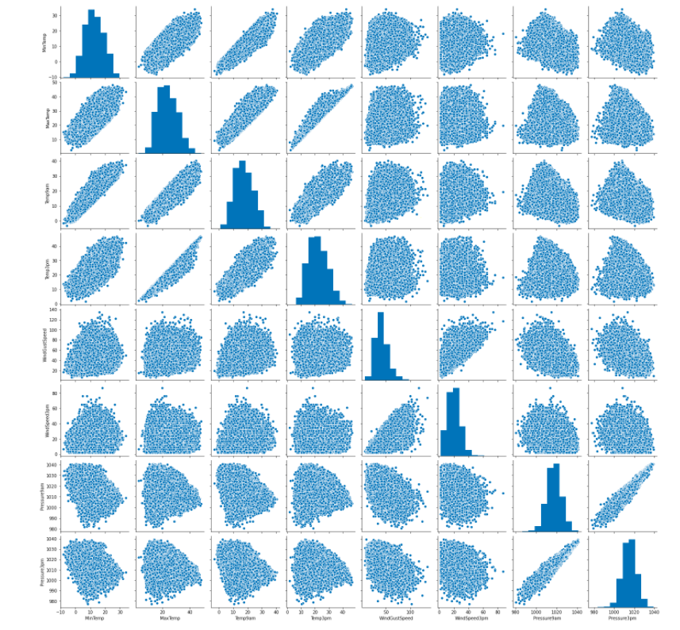

Slide 8
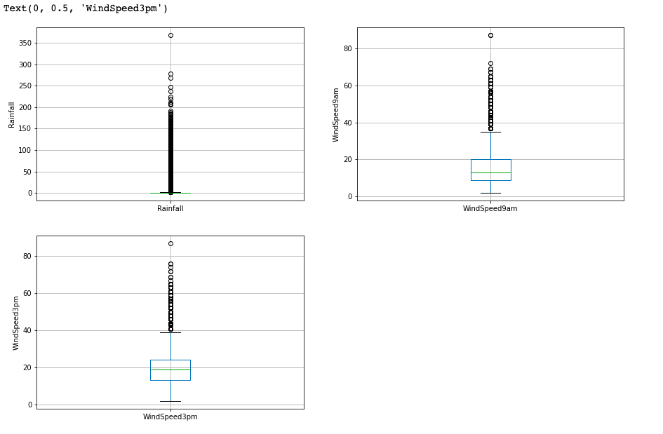
Checking for Outliers

Slide 9
Data Preprocessing
The dataset is stored in BigQuery.
The preprocessing is done using Jupyter Notebooks in AI Platform
The datatypes of the columns are corrected.
The columns that have less than 60% of data are dropped.
The rows that consist of missing values in any of the columns are dropped.
Outliers are handled using top-coding approach.
Categorical data is encoded using One Hot Encoding as Logistic Regression cannot handle categorical data.

Slide 10
Machine Learning Model
A Logistic Regression model is trained using BigQuery ML.
The query used to create the model is :
CREATE OR REPLACE MODEL
`thematic-flash-266714.australia_weather.model`
OPTIONS
( model_type="logistic_reg",
input_label_cols=["RainTomorrow"] ) AS
SELECT * FROM
`thematic-flash-266714.australia_weather.preprocessed`

Slide 11
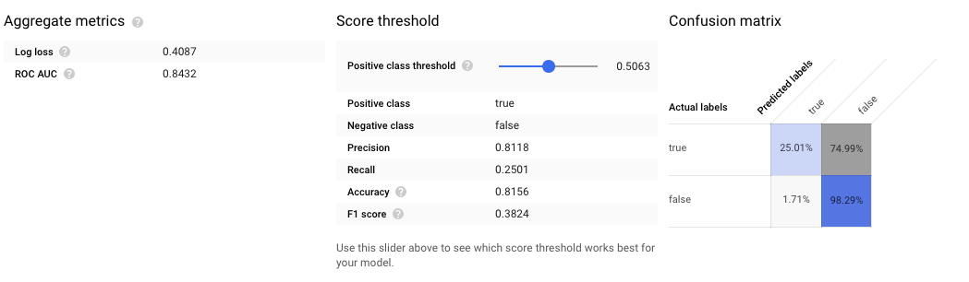
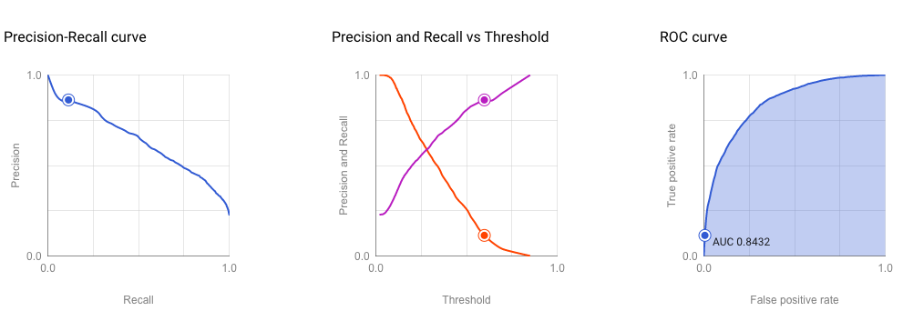

Slide 12
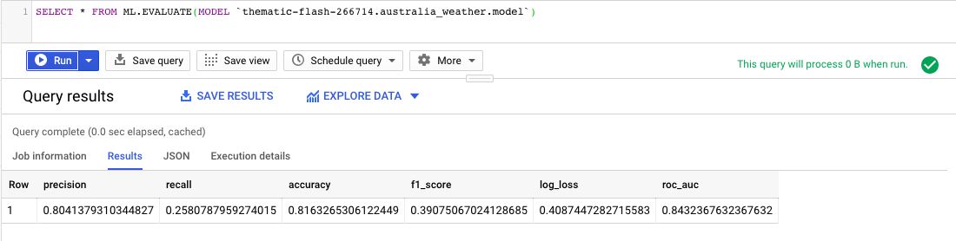
Evaluating the Model
We use the following query to evaluate the model
SELECT * FROM ML.EVALUATE(MODEL `thematic-flash-266714.australia_weather.model`)

Slide 13
Conclusion
The accuracy of the model is 0.82 and precision is 0.80 which is good for a classification model.
But the recall and f1-score is low, which implies that the model needs improvement.
The performance of the model suffers due to the unbalanced dataset.

Slide 14
THANK YOU!

